Slide 1

Update to AABE on DOE Smart Grid Investment Grants and Smart Grid Regional Demonstrations
Christopher Irwin
Smart Grid Standards and Interoperability Coordinator
Office of Electricity Delivery and Energy Reliability
Notes:
1

Slide 2
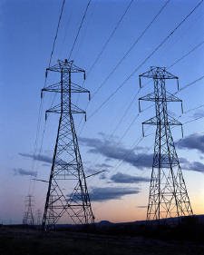
“We’ll fund a better, smarter electricity grid and train workers to build it… ”
President Barack Obama
“To meet the energy challenge and create a 21st century energy economy, we need a 21st century electric grid”
DOE Secretary Chu
GridWeek, September 2009
Notes:
EPact 2005 and EISA 2007 made the grid a national priority. This President and this Secretary are committed to this like few others before which is critical, since there are thousands of tasks we need to accomplish on every front.

Slide 3
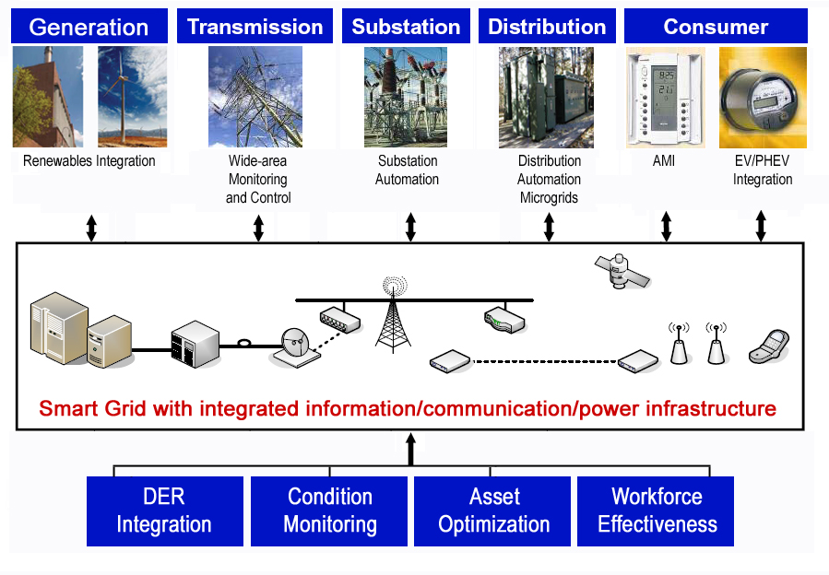
Smart Grid Enables Dynamic Optimization of Grid Resources and Operations
3

Slide 4
Defining Smart Grid
DOE has defined the smart grid in terms of seven characteristics that are outcomes – Smart Grid technology contributing to & realizing the outcomes
Seven Defining Outcomes of the Smart Grid
  Enables Informed Participation by Customers
  Accommodates All Generation and Storage Options
  Enables New Products, Services, and Markets
  Provides the Power Quality for the Range of Needs
  in the 21st Century
  Optimizes Asset Utilization and Operating Efficiently
  Addresses Disturbances – Automated Prevention, Containment, and Restoration
  Operates Resiliently Against Physical and Cyber
  Attacks and Natural Disasters
4
Notes:
4

Slide 5
American Recovery and Reinvestment Act Jumpstarts Smart Grid
Office of Electricity Delivery and Energy Reliability | $ Millions
Smart Grid Investment Grant Program; ≤3 years | $3,400
Smart Grid Demonstrations; 3-5 years | $615
Interoperability Framework Development by NIST | $10
Resource Assessment and Interconnection-Level Transmission Analysis and Planning | $80
State Electricity Regulators Assistance | $50
Enhancing State Government Energy Assurance Capabilities and Planning for Smart Grid Resiliency | $55
Workforce Development | $100
94 of 100 SGIG Awards Complete!
5
Notes:
The American Recovery and Reinvestment Act is one of the tools provided by our leadership, and funds are flowing through several program offices to make the best possible use of this tool. Here’s what the Office of Electricity is doing…

Slide 6
ARRA Smart Grid Investment Grants
Transform Electricity Delivery
Smart Grid Systems and Equipment | Numbers of Units (self-reported estimates) | Improvements | Impacts
Networked Phasor Measurement Units | 877 | Near-nationwide coverage 6X the 166 existing networked PMUs | Enhanced situational awareness and electric system reliability and resiliency
Smart Transformers | 205,983 | Enables preventative maintenance
Automated Substations | 671 | 5% of 12,466 transmission and distribution substations in the U.S.
Load Control Devices | 176,814 | Enables peak demand reductions | 1444 MWs of peak demand reduction per year (self-reported estimates)
Smart Thermostats | 170,218 | Enables peak demand reductions
Smart Meters | 18,179,912 | 13% of the 142 million customers in the U.S. | Transformational changes in consumer behavior and energy consumption
In-Home Display Units | 1,183, 265 | Enables customer empowerment
PHEVs/Charging Stations | 12/100 | Accelerates market entry | Begins the path toward energy independence
Notes:
6

Slide 7
ARRA SG Demonstration Program
Regional Smart Grid & Energy Storage
Demo Program Type | No. | Impacts | DOE Funding
Regional Demonstrations | 16 | Integrate existing SG technologies in regional applications that can be replicated across the US | $435M
Battery Storage for Utility Load Shifting or for Wind Farm Diurnal Operations and Ramping Control | 3 | Smooth, ramp control, & shift peaks of wind with Li ion, flow batteries & other advanced systems in 8-25 MW range | $61M
Frequency Regulation Ancillary Services | 1 | Test flywheels or batteries in 1-2 MW range Demo fast 20 MW flywheel storage device for grid scale frequency regulation | $24M
Distributed Energy Storage for Grid Support | 5 | Demo frequency regulation, demand management, community energy storage, & peak shifting with lead carbon, Li ion, flow batteries & others in 1-3 MW range | $20M
Compressed Air Energy Storage | 2 | Use off-peak electricity to compress air into storage to serve on-loads with Compressed Air Energy Storage in 150-300 MW range | $55M
Demo of Promising Energy Storage Technologies | 5 | Bring lab concepts to functioning prototype: advanced batteries, flow batteries, flywheels, & compressed air | $25M
Total Demo Projects | 32 | Gather data & show benefits | $620M

Slide 8
Outcomes
Deliver on the stimulus mission.
Deliver on grid modernization.
Maintain a transparent system.
Create the best data-backed national perspective on Smart Grid deployments.

Slide 9

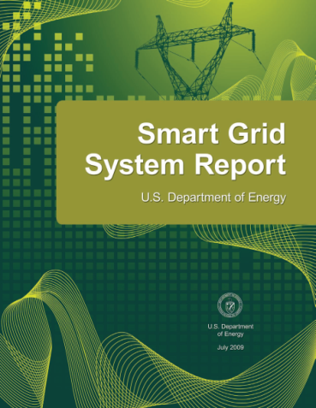
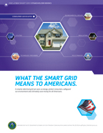



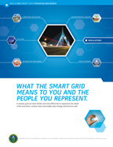
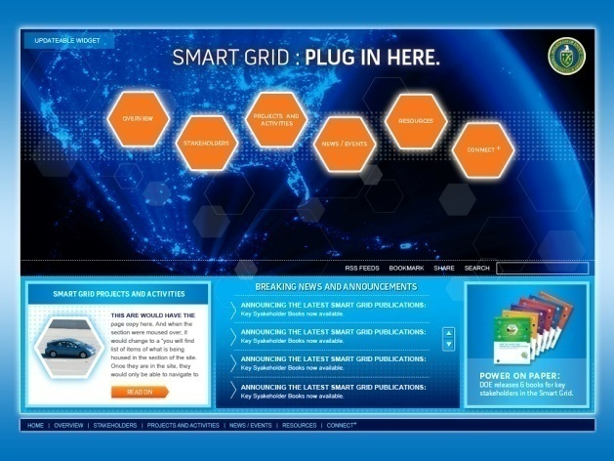
Smart Grid Resources
Smart Grid System Report (2009)
Smart Grid Metrics for Measuring Progress
Smart Grid – Introduction and Stakeholder books
Smart Grid Maturity Model
Smart Grid Information Clearinghouse
SmartGrid.gov
9

Slide 10
Contact Information
Christopher Irwin
Office of Electricity Delivery and Energy Reliability
U.S. Department of Energy
christopher.irwin@hq.doe.gov
For more Smart Grid Information:
OE: www.oe.energy.gov
Smart Grid: www.smartgrid.gov
Smart Grid Task Force: www.oe.energy.gov/smartgrid_taskforce.htm
10
Notes:
Thank you.

